Slide 1
DATA VISUALIZATION

Slide 2
GRAMMAR OF GRAPHICS GRAMMATICAL ELEMENTS ARE
DATA
AESTHETICS- what you map on the x and y axis
GEMETRIES – how data will be represented visually
FACETS – the discrete subplots the graph can be split into
STATS- the statistical transformation
COORDINATES – where you want your data plotted
THEMES – the non data additional elements like color, font etc

Slide 3
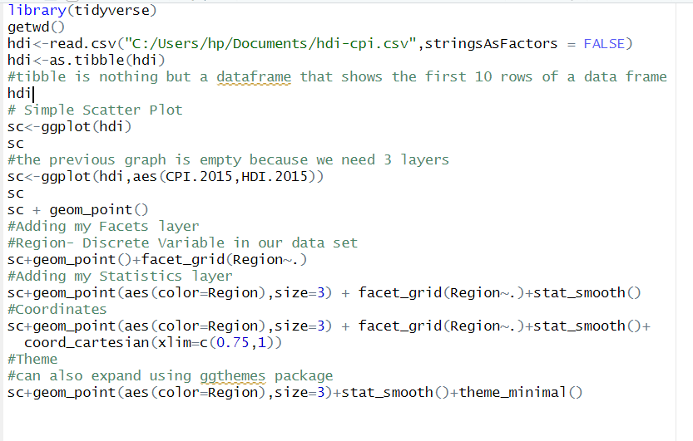
INTRODUCTION TO GGPLOT2 PACKAGE
Recall : 7 layers to a graph
First 3 layers are mandatory.

Slide 4
TWO TYPES OF DATA
Categorical Data- describes categories/groups , yes/no answers
Numerical can be discrete, continuous
Discrete – can be counted in a finite way
Continuous- infinite and impossible to count
4 Types of Variables- Nominal, Ordinal, Interval, Ratio
Nominal – not numbers that cannot be meaningfully ordered( winter, summer, autumn, spring)
Ordinal- groups and categories in a strict order
Interval- represented by numbers, no true ZERO
Ratio-represented by numbers, true ZERO

Slide 5
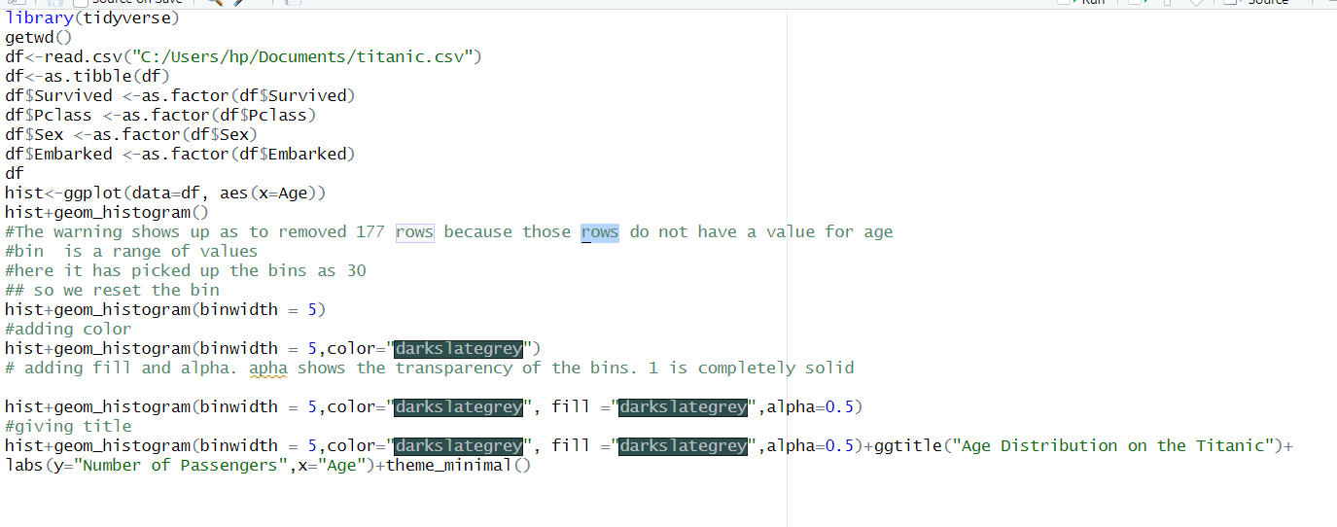
HISTOGRAMS
Are excellent for numeric data especially if its continuous and you’re interested in frequencies

Slide 6
Exercise
Using the employees data, plot the salary frequencies. Limit the salaries under consideration to only those above 45,000 per year.
Choose an appropriate binwidth, and appearance.
Title the x axis as “Salary”, and the y axis as “Number of employees in the salary bracket”.
Title the plot as “Salary distribution in the employee data”.
Install the ggthemes package and chose a theme from there. Look at the descriptions of each and choose one that has modifiable size and font family. Increase the size and set the font family to serif.

Slide 7
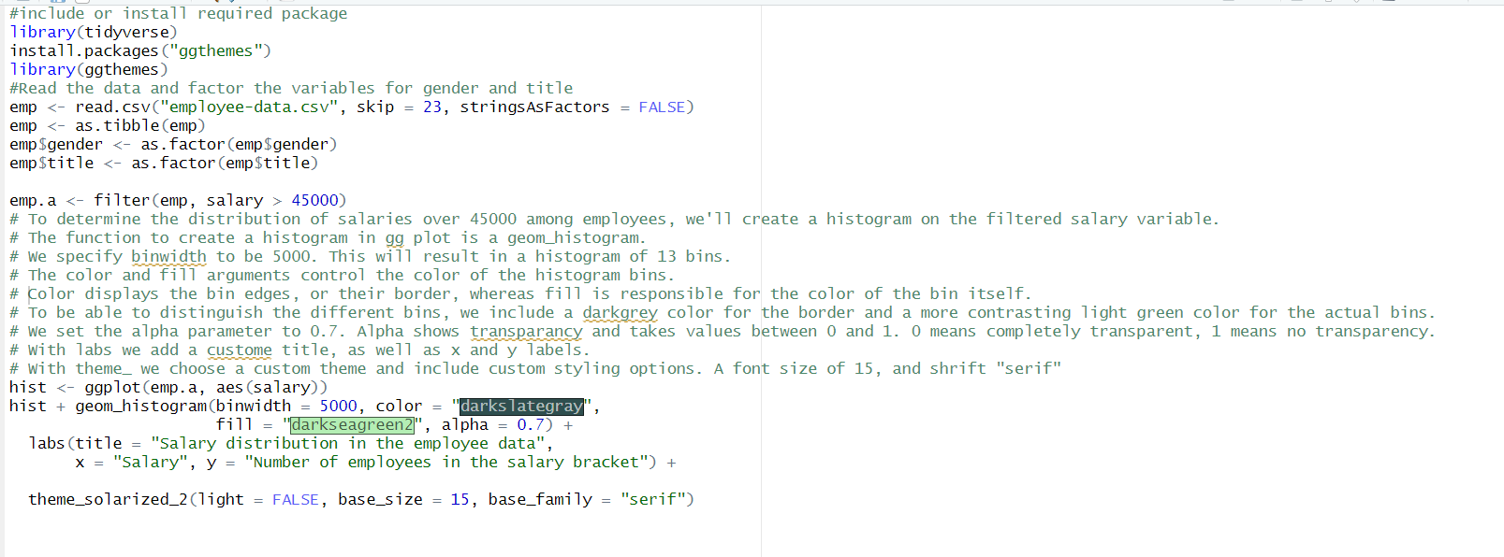
Solution: Try the Code !!

Slide 8
Bar Chart , Box Plot
Bar Chart looks like a histogram but the bars are actually bars and not bins
Box Plot represents grouped numerical data in terms of quartiles.
Lowest data point, First quartile, Median, third quartile, highest data point.
geom_boxplot(…,coef= )changes the interquartile range
Otherwise the lower quartile and higher quartile is between 1.5
The line in between is the median
The left edge of the box represents the lower quartile; it shows the value at which the first 25 % of the data falls up to. The right edge of the box shows the upper quartile; it shows that 25 % of the data lies to the right of the upper quartile value

Slide 9
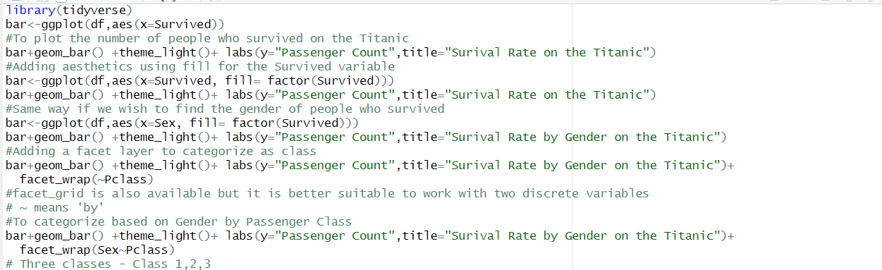
BAR CHART USING TITANIC DATASET

Slide 10
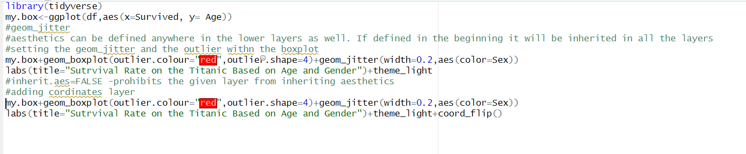
BOX PLOT USING TITANIC DATASET

Slide 11
Exercise
Create a bar chart representation of the number of employees in the different positions in the employees data by gender. Set the theme.
Add plot title “Job positions by gender”, and axes titles: “Job position”, and “Employee count”. Can you do that?
Try setting the theme to something different and give it another go.
Look up the scale_fill_manual() and scale_color_manual() functions. Try setting custom colors to your plot.
Try to change the position on the canvas the legend is in. Use the theme() function to do that.
Try to reverse the aesthetic mappings. Does this graph give you a better idea of your data? Is it easier to read? (Shouldn’t be 😊)

Slide 12
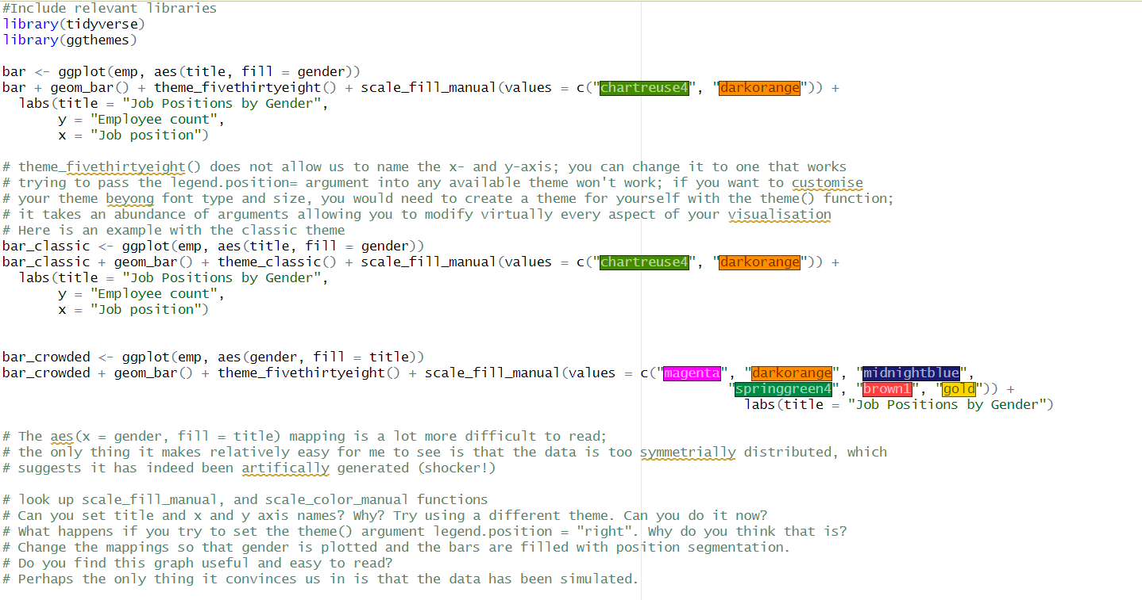
SOLUTION!

Slide 13
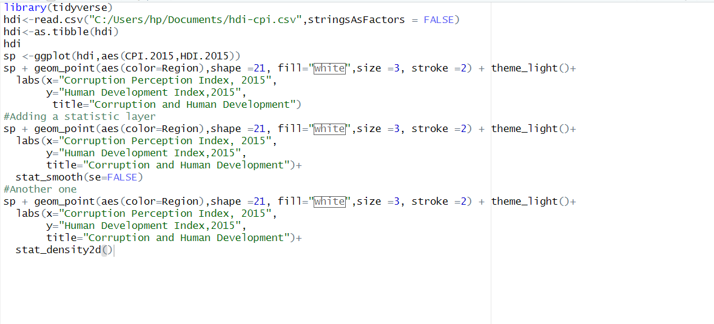
SCATTER PLOT
Is the visual representation of the relationship between two numerical variables

Slide 14
Scatter Plot
Create a scatter plot of the price and area of the California real estate data. You can download the data set, called real_estate.csv
After creating the initial scatter plot, add an additional color feature based on the building type.
Also increase the size of each scatter point to 2.
The next step is chart styling. You can start with formatting the legend. You can remove the legend for size. Hint: use guides() and set size to FALSE.
Use a custom theme.
Move the legend to the top left corner of the chart. Hint: You can use theme() and the arguments legend_position, and legend_justification
Add a chart title, as well as custom x- and y-axis labels.
Lastly, think about chart interpretation? What does the plot represent?

Slide 15
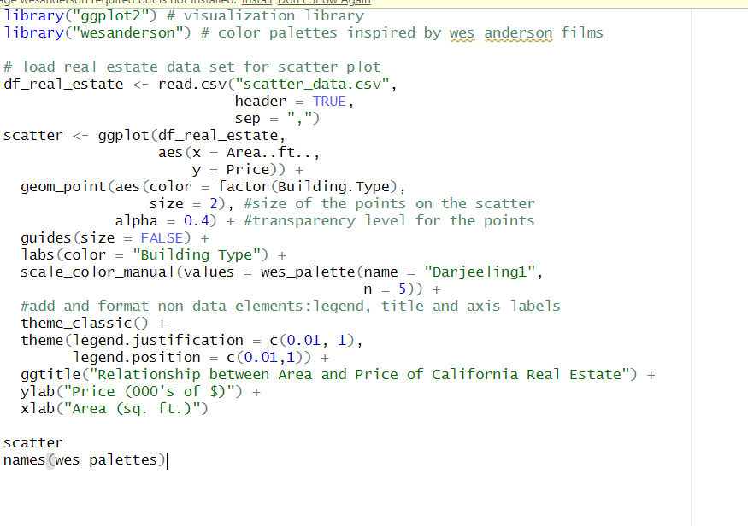
Solution!!

